Slide 1
Introduction to Unifrog

Slide 2
How can I get the most out of Unifrog?
Thursday, 11 July 2024
By the end of this lesson, you will;
Know how your personality may affect what careers you suit
Be aware of different careers that might suit you
Understand the entry requirements for your possible career

Slide 3
What is ?

Slide 4
Task One
Thursday, 11 July 2024
Log onto Unifrog (you should have done this but if you have not here should be an email in your inbox form September time)
If you can’t find it https://www.unifrog.org/sign-in and click reset password/resend welcome email

Slide 5
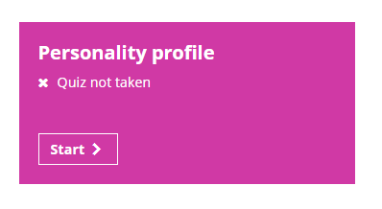
Task 2
Thursday, 11 July 2024
Complete personality profile, this is a fun task that will allow you to learn a little about yourself and the different careers which you might enjoy in the future
Notes:
This takes about 12 minutes, show the video https://www.loom.com/share/e3a8dba592854e8ea55cf3679f8b1b7d

Slide 6
Task 3
Thursday, 11 July 2024
Once you have completed the Personality profile check out your results. Here you will find a link to the careers that you might be interested in.
Using the link, exploring the suggested careers and favourite at least one career profile in the Careers library
Notes:
Show video https://www.loom.com/share/9bdd885789b74743971796d167440251

Slide 7
Task 4
Thursday, 11 July 2024
Once you’ve found a career that you are interested in, read the career’s profile. Here you will find lots of useful information relating to that career.
Make a note in your booklet of any of the following:
What are the entry requirements for this career, are there any specific subjects/qualifications you will need?
Will you need a university degree? If so, make a note of the subject you will need to study.
Could you access this career through any other route (i.e an apprenticeship or internship)? If so, make a note of the sector you should look for opportunities in.
Now go to the Post 16 Intentions tool and record your dream career and two pathways to reach your chosen career in your booklet
Notes:
Show the video https://www.loom.com/share/3df9210507e14d43bdc244ad7dba79c2

